Slide 1

Introduction to Load Balancing and Azure Load Balancing

Slide 2
Load Balancing Options
Azure Load Balancer
Azure Application Gateway
Azure Traffic Manager
AWS Network Load Balancer
AWS Application Load Balancer
AWS Route 53
Google Network Load Balancer
Google Application Load Balancer
Google Cloud DNS

Slide 3
TABLE OF CONTENT
Context of load balancing
  Traditional application architecture
  HA
  Load balancing
  Load Balancing Options
Introduction to Azure Load balancer
  What is Azure Load Balancer
  Benefits of Azure Laoad Balancer
Azure Load balancing Options
    Azure Load Balancer, Application Gateway, Traffic Manager, Front Door
  Azure Load balancer categorizations
    Global vs reginal
    HTTP(S) vs. non-HTTP(S)
  Azure load balancing decision tree explained
    Choose solution using portal

Slide 4


Context of Load Balancer
Traditional application architecture
High Availability
Load balancing
Load Balancing Options

Slide 5
Traditional application architecture

Slide 6
High Availability (HA)
Component level redundancy – HA
Server level redundancy – HA
  Server level redundancy can be achieved with clustering
  Active – Active Clustering
  Active – Passive Clustering
Active – Active Clustering is load balancing

Slide 7
Introduction to Load Balancer
A load balancer is a device that distributes network or application traffic across a cluster of servers. Load balancing improves responsiveness and increases availability of applications.
A load balancer distributes traffic evenly among each system in a pool. A load balancer can help you achieve both high availability and resiliency.
Hardware
Software
Appliance
Notes:
Explain this first
The problem here is that each VM would have its own IP address. Plus, you don't have a way to distribute traffic in case one system goes down or is busy. How do you connect your VMs so that they appear to the user as one system?
The answer is to use a load balancer to distribute traffic. The load balancer becomes the entry point to the user. The user doesn't know (or need to know) which system the load balancer chooses to receive the request.

Slide 8
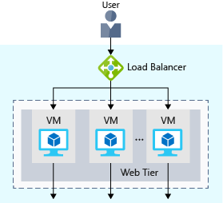

Slide 9
Load Balancing Options
A load balancer is a device that distributes network or application traffic across a cluster of servers. Load balancing improves responsiveness and increases availability of applications.
Layer 4
Layer 7
DNS Level

Slide 10
Load Balancing Options
 | Azure | AWS | Google Cloud
Layer 4 | Azure Load Balancer | AWS Network Load Balancer | Google Network Load Balancer
Layer 7 | Azure Application Gateway | AWS Application Load Balancer | Google Application Load Balancer
DNS Level | Azure Traffic Manager | AWS Route 53 | Google Cloud DNS

Slide 11
Introduction to Azure Load Balancer
What is Azure Load Balancer
Benefits of Azure Load Balancer

Slide 12
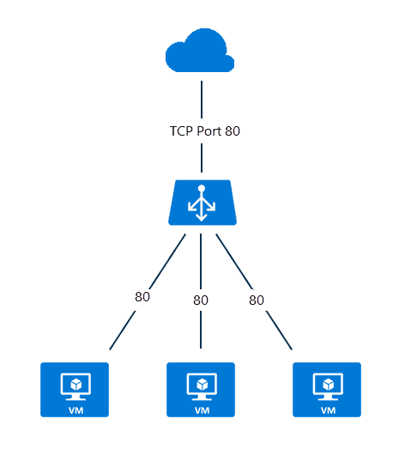
What is Azure Load Balancer
Azure Load Balancer is a managed load balancer service that Microsoft provides as a service.
It is a PaaS offering.
Notes:
The term load balancing refers to the distribution of workloads across multiple computing resources. Load balancing aims to optimize resource use, maximize throughput, minimize response time, and avoid overloading any single resource. It can also improve availability by sharing a workload across redundant computing resources.

Slide 13
Benefits of Azure Load Balancer
Microsoft completely Manages Load Balancer Service.
No ICM
No capacity planning
No HA planning
Only pay for what we use.

Slide 14
Azure Load Balancing Options
Azure load balancing options
Azure Load Balancer Categorization
Azure Load balancer decision tree
Notes:
Azure load balancing options
Azure Load Balancer
Application Gateway
Traffic Manager
Front Door
Azure Load Balancer Categorization
Global vs Regional
Https vs http
Azure Load balancer decision tree
Decision Tree Explained
Choose solution using portal

Slide 15
Azure Load Balancer options
Azure provides various load-balancing services that you can use to distribute your workloads across multiple computing resources.
These resources include:
Azure Load Balancer
Azure Application Gateway
Azure Traffic Manager
Azure Front Door

Slide 16

Azure Load Balancer
Azure Load Balancer is a high-performance, ultra-low-latency Layer 4 load-balancing service (inbound and outbound) for all UDP and TCP protocols.
It's built to handle millions of requests per second while ensuring your solution is highly available. Load Balancer is zone redundant, ensuring high availability across availability zones.
It supports both a regional deployment topology and a cross-region topology.

Slide 17

Azure Application Gateway
Application Gateway provides application delivery controller as a service, offering various Layer 7 load-balancing capabilities.
Use it to optimize web farm productivity by offloading CPU-intensive SSL termination to the gateway.

Slide 18

Azure Traffic Manager
Traffic Manager is a DNS-based traffic load balancer that enables you to distribute traffic optimally to services across global Azure regions, while providing high availability and responsiveness.
Because Traffic Manager is a DNS-based load-balancing service, it load balances only at the domain level.
For that reason, it can't fail over as quickly as Azure Front Door, because of common challenges around DNS caching and systems not honoring DNS TTLs.

Slide 19

Azure Front Door
Azure Front Door is an application delivery network that provides global load balancing and site acceleration service for web applications.
It offers Layer 7 capabilities for your application like SSL offload, path-based routing, fast failover, and caching to improve performance and high availability of your applications.

Slide 20
Azure Load Balancer Categorizations
Global vs Regional
HTTP(S) vs non-HTTP(S)

Slide 21
Global vs Regional
Global: These load-balancing services distribute traffic across regional back-ends, clouds, or hybrid on-premises services. These services route end-user traffic to the closest available back-end. They also react to changes in service reliability or performance to maximize availability and performance. You can think of them as systems that load balance between application stamps, endpoints, or scale-units hosted across different regions/geographies.
Regional: These load-balancing services distribute traffic within virtual networks across virtual machines (VMs) or zonal and zone-redundant service endpoints within a region. You can think of them as systems that load balance between VMs, containers, or clusters within a region in a virtual network.

Slide 22
HTTP(S) vs. non-HTTP(S)
HTTP(S): These load-balancing services are Layer 7 load balancers that only accept HTTP(S) traffic. They're intended for web applications or other HTTP(S) endpoints. They include features such as SSL offload, web application firewall, path-based load balancing, and session affinity.
Non-HTTP(S): These load-balancing services can handle non-HTTP(S) traffic, and we recommend them for nonweb workloads.

Slide 23
Azure Load Balancing Tree Explained
Decision Tree Explained
Choose solution using portal

Slide 24
Decision tree for load balancing in Azure
Traffic type: Is it a web (HTTP/HTTPS) application? Is it public facing or a private application?
Global vs. regional: Do you need to load balance VMs or containers within a virtual network, or load balance scale unit/deployments across regions, or both?
Availability: What's the service-level agreement?
Cost: For more information, see Azure pricing. In addition to the cost of the service itself, consider the operations cost for managing a solution built on that service.
Features and limits: What are the overall limitations of each service? For more information, see Service limits.

Slide 25
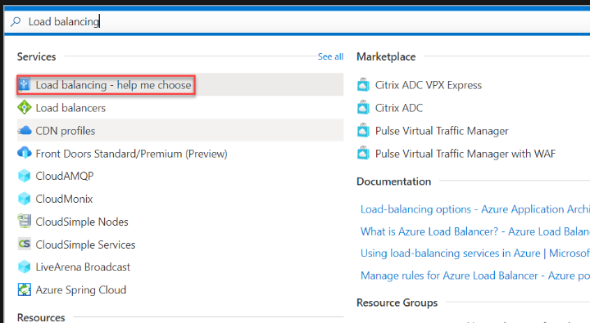
Choose a load-balancing solution by using the Azure portal

Slide 26
Next Steps
Master Azure Load Balancers
Designing Microsoft Azure Infrastructure Solutions
Designing and Implementing Microsoft Azure Networking Solutions

